Slide 1
Week 7 Day 2

Slide 2
Module 2
Pronunciation Review/practice
Module 2 introduction
Feedback Exam 1. Check my comments. Concrete Qs?
Pauses and focused words
Learning English through music.

Slide 3
Review: /d/ /t/ /ɪd/
Read the following words and identify the correct ed ending pattern:
/t/ sound: walked, watched, rushed, talked
/d/ sound: seemed, played, rained, stopped
/ɪd/ sound: decided, rested, headed

Slide 4
Practice: /d/ /t/ /ɪd/
Yesterday, I walked to the park, where I watched some kids playing soccer. They seemed excited, and I decided to join them. We played for an hour until it started to rain. When it rained, everyone rushed to their cars. I was so tired, I just rested on a bench until the rain stopped. Afterward, I talked with a friend about how much fun we had. Finally, I headed home, feeling satisfied with my day.

Slide 5
Practice: /d/ /t/ /ɪd/
https://live-english.net/learning/pronunciation/ed-pronunciation/
Go to exercise 3 and do it. Then practice reading it.

Slide 6
Module 2
Go to bloque Neon and read the Module 2 presentation/description. Find out contents and learning objectives.
Now go to week 7 and get familiar with the objectives and contents.

Slide 7
Thought Groups
Read the following sentences and identify how many pauses each sentence has and the words that are stressed.
1. Next, I’d like to discuss the news sources and the people that spread this story.
Next// I’d like to discuss// the news sources// and the people that spread this story.
2. I would classify this story as an example of both disinformation and misinformation.
2. I would classify this story// as an example of both// disinformation and misinformation.

Slide 8
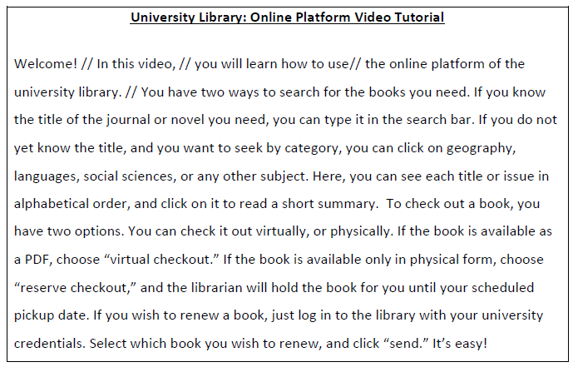
Feedback: did you do it?
Read and listen to the audio. First mark the pauses (//) and then highlight the words that are stressed. Practice before recording your audio. Try to imitate the pauses and the pronunciation used in the audio.

Slide 9
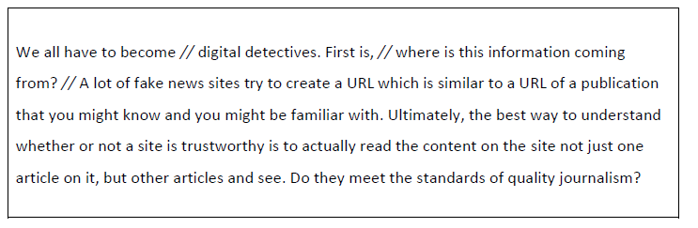
Chunking and Thought Groups
Follow these steps:
Listen to the first part of the video and mark the pauses as you hear them.
Underline the words (stressed words)
Listen again and check your answers.
Practice: take turns reading with the correct pauses and the stressed words.
https://www.youtube.com/watch?v=y7eCB2F89K8

Slide 10

Songs to improve our speaking
Using songs is also another way to practice many aspects of the language:
Grammar
New vocabulary
Intonation
Pronunciation
Expressions.

Slide 11
Week 7 Day 3

Slide 12
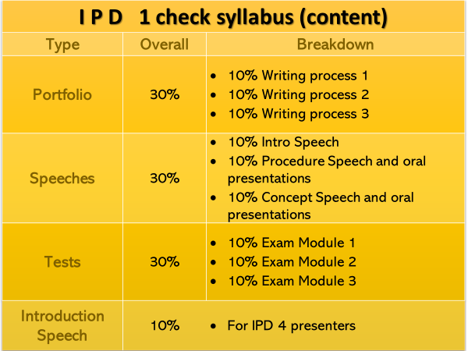

Slide 13
IPD Academic Events
Tentative dates
IPD 2 Poster Presentations - Week 8 – Sept 27th
IPD 3 Three Minute Thesis - Week 14 – Nov 15th
IPD 4 Final Conference - Week 16 – Nov 27th
IPD 1. Chairs of the final conference. You will be the chair or the session moderator of this event. Email and interview IPD 4 students. Interviews: Week 10– Prepare your intro speech to be the moderator of the event.
IPD Breakfast: All IPDers come. Octo 11th at Uniandes 8-9:30am (Friday of Week 9)

Slide 14
Reminders
Recess week No classes
Module 2………………………………………… 5 weeks
Module 3 ………………………………………… 5 weeks
IPD2 poster presentation. Atendance is mandatory.
You need to participate in at least three presentations (asking questions and becoming familiar with the presentation, giving your opinion). We will talk and report on these presentation after recess week.

Slide 15
Asynchronous work
Read pgs. 280-289 (Oshima & Hogue) → Some Punctuation Rules. BN (Material)
Add the right punctuation to the following sentences. Copy and paste your answers in your portfolio.
A specific student will have to explain a specific punctuation mark

Slide 16
ADD THE RIGHT PUNCTUATION
1. The Student Learning Center offers many special services the library which opens at 8:am individual tutoring special classes in math reading writing and computer skills study groups and vocational mindfulness psychodynamic and professional therapies
2. To check a book out of the library you should follow this procedure Write down the call number of the book find the book take it to the circulation desk fill out the card and show your student I.D.
1. The Student Learning Center offers many special services the library which opens at 8:am individual tutoring special classes in math reading writing and computer skills study groups and vocational mindfulness psychodynamic and professional therapies
2. To check a book out of the library you should follow this procedure Write down the call number of the book find the book take it to the circulation desk fill out the card and show your student I.D.

Slide 17
Presentations Next Week
Topic | Pages | Presenters and days
Comma | Pg. 280-281 | Ryoko & Victor Monday
Semicolon | Pg. 283 | Mar & Emilio  Tuesday
Colon | Pg. 285-287 | Andrés SanabriaWednesday
Despite, Inspite of, although, even though | Grammar PFD (bloque Neon) Material | Xio & Yuly Friday (week 7)

Slide 18
Oral presentation
These presentations will begin this Friday. You can prepare this during asynchronous class (Thrusday)
The group can take 20 minutes for the presentation.
You are expected to explain the topic assigned, create an activity(ies) to practice, and evaluate if your students have learnt the topic.
The presentations will be evaluated. Both presenters need to speak equally.

Slide 19
Oral presentation
Criteria | J | K | L
The explanations and examples were clear and pertinent. | 8.3 | 6 | 4
The students used visual aids for the presentations. | 8.3 | 5 | 4
The students prepared good practice activities | 8.3 | 6 | 4
The topic was presented in 25 minutes (max). | 8.3 | 5 | 4
The two presenters were involved in planning and delivering the presentation. | 8.3 | 6 | 4
Students seem to have understood everything related to the punctuation mark. | 8.3 | 6 | 4
Total | 50

Slide 20
DESCRIPTIVE PARAGRAPH
This paragraph offers specific details and sensory images to give a picture
Introductory activity in BN. Download the file and work in groups.

Slide 21
DESCRIPTIVE PARAGRAPH
This paragraph offers specific details and sensory images to give a picture.
These texts help the reader to imagine a scene, a person, a place or an object
It uses sensory senses: taste, smell, sight, touch, hearing
It provides lots of details so that the reader can imagine what is being described.

Slide 22
DESCRIPTIVE PARAGRAPH
Video: to learn how to use our senses in descritive texts.
https://www.youtube.com/watch?v=Uy-qqguRrYY

Slide 23
Week 7 Day 4

Slide 24
DESCRIPTIVE PARAGRAPH
This paragraph offers specific details and sensory images to give a picture

Slide 25
Purpose
Descriptive paragraphs could be very useful for giving detailed information in:
A research journals/logs/diaries
Qualitative research
Write reports
If you want to read more about descriptive paragraphs, go to Bloque Neón→ Material → Books → Descriptive paragraphs

Slide 26
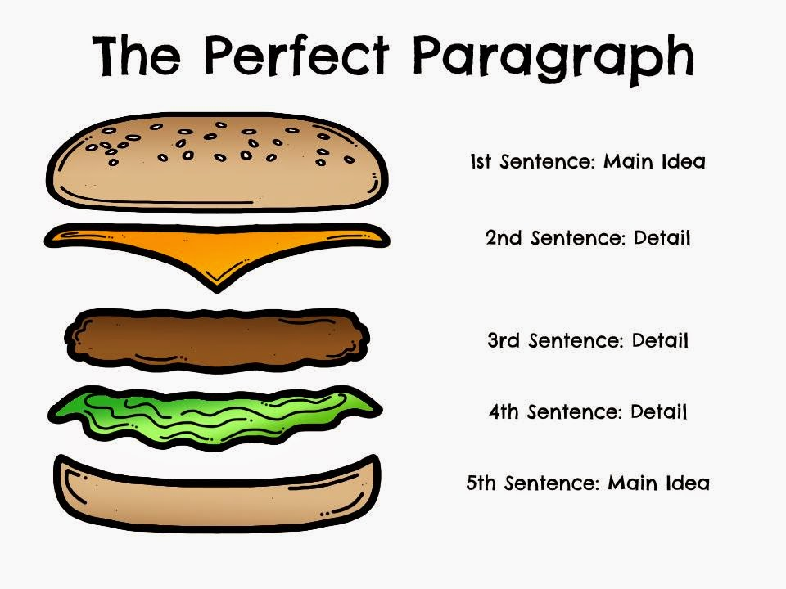
PARAGRAPH STRUCTURE
➔
➔
➔
➔
➔
TOPIC SENTENCE
Supporting Sentence 1
Supporting detail 1
Supporting Sentence 2
Supporting detail 2
Supporting Sentence 3
Supporting detail 3
Concluding Sentence

Slide 27
TOPIC SENTENCENTE
It should name the topic and the controlling idea
The controlling idea should give the overall impression of the place/person/object you are describing:
Example:
1. When I was two or three years old, I lived in a house that had a strange atmosphere.
2. My bedroom at home is my refuge from the outside world.
3. The campus of our school is like a small city.
4. The cafetería at lunch time is the school’s social center.

Slide 28
SUPPORTING SENTENCES
They are the “meat” of that hamburger.
They provide details that prove that your topic sentence is true.
The more details you include, the more clearly your reader will imagine what you are describing.
They should tell the reader how something looks, smells, sounds, feels and tastes.
You can include: colors, sizes, shapes odors, noises and textures.

Slide 29
WAYS OF ORGANIZING PARAGRAPHS
Location order is very common in this type of paragraphs. Geographic or spatial order
Listing order: A series of events.
Listing details: describing the event/object/person
Time Order: Chronological order.
Importance Order: Most to least
Comparison-Contrast Order: Similarities and/or differences

Slide 30
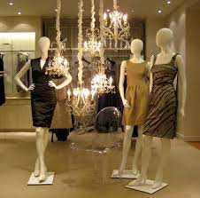

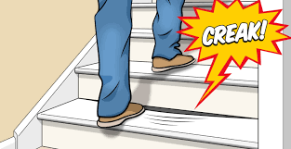
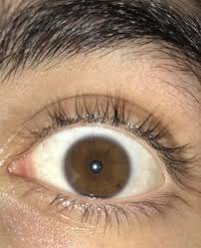

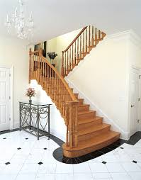
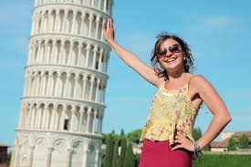
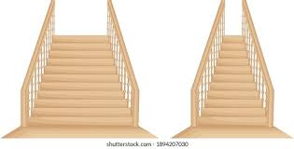
Vocabulary
Blink
Leaning
Narrow
Fixed eyes/piercing eyes
Tinge
Squeaking
Bottom/top of the stairs
mannequin

Slide 31
Identify the organization
When I was two or three years old, I lived in a house that had a strange atmosphere. I do not remember much about the house except the stairs. They were dark, squeaking, and narrow, and a little high for me to climb up. From the bottom of the stairs, it seemed like an endless climb to the top. At the top of the stairway, there was an elegant, middle-aged lady leaning against the wall. I had to pass her every time I went to my room, for my room was the first room after the stairs on the second floor. The lady wore a beautiful dress with a tinge of blue, and her peaceful eyes looked at me every time I went up the stairs. As I carefully climbed up, her eyes became fixed on me. She did not talk or move. She just stood there and watched me climb up the stairs. One day, I touched her, but she did not react. Her face did not change expression, nor did she even blink. She just kept looking at me with her piercing eyes. Later, we moved out of the house, and I never saw her again. Now, I know that the lady was a mannequin. It was used for a dress-making class. I did not know my mother. I imagined that the mannequin at the top of the stairs was my mother. The stairway with the strange atmosphere has an important place in my memory.

Slide 32
When I was two or three years old, I lived in a house that had a strange atmosphere. I do not remember much about the house except the stairs. They were dark, squeaking, and narrow, and a little high for me to climb up. From the bottom of the stairs, it seemed like an endless climb to the top. At the top of the stairway, there was an elegant, middle-aged lady leaning against the wall. I had to pass her every time I went to my room, for my room was the first room after the stairs on the second floor. The lady wore a beautiful dress with a tinge of blue, and her peaceful eyes looked at me every time I went up the stairs. As I carefully climbed up, her eyes became fixed on me. She did not talk or move. She just stood there and watched me climb up the stairs. One day, I touched her, but she did not react. Her face did not change expression, nor did she even blink. She just kept looking at me with her piercing eyes. Later, we moved out of the house, and I never saw her again. Now, I know that the lady was a mannequin. It was used for a dress-making class. I did not know my mother. I imagined that the mannequin at the top of the stairs was my mother. The stairway with the strange atmosphere has an important place in my memory.
Notes:
Example of location order
In purple : we see prepositions of place (geographical order9
In Green the details. That is why we have a lot of description with colors, sizes, impressions, shapes,

Slide 33
Prompt used
Write a DESCRIPTIVE PARAGRAPH.
TOPICS:
Describe an event/place/object/person or a particular situation that is memorable for your profession/ your academic work.
Process:
Start by writing sentences using the 5 senses.
Identify key vocabulary related to your professional career.
Try to image the picture you want the reader to image.
Write your first draft.

Slide 34
Using the 5 senses for brainstorming
I could see a small classroom equipped with an old tape recording, a television with a VHS (short for Video Home System), a small white board, and some blue chairs for students.
I saw a group of 4 young students who were waiting for the teacher to begin the class. They seem shy but willing to participate.
I could hear the students and teachers’ voices. Also, the coordinator and the secretary were speaking loudly as I walked to the classroom I was assigned to.
I could smell the markets’ ink whenever I use the market.
I could feel my heart beating as this was my first class, and I wanted to do a good job.
I was thirsty because I was stressed.
As I was teaching the class, I felt more confident and relaxed.
My classroom was at the back of the house; closed to patio.
Notes:
They can use this strategy to begin with preliminary ideas. They are also useful for identifying key vocabulary of a field. Ask students. What do you think the paragraph is about, who writes the paragraph? What kind of objects or aspects Will the author describe?

Slide 35
Key vocabulary of my field
I have been an English teacher for almost 20 years now, but I can never forget the first time I taught an English class. The first thing I remember was the language institute; it looked like any other traditional big house in Galerias, except that instead of rooms, there were classrooms and offices. Also, I remember that the classrooms were all very small, but each one was well equipped with a small white board, old tape recordings, a TV with VHS (Video Home Systems), and some single arm blue chairs for students. The classroom I was assigned to was closed to the backyard of the house, very far away from the coordinator’s office. Although it was a tiny classroom, I liked it because it gave me some privacy where no one could judge or evaluate my class pedagogy or activities. Despite having prepared each of my class activities carefully, I felt stressed. My heart was beating so fast because I wanted to do a good job as a first time English teacher. After I entered the classroom, my students’ eyes became fixed on me. However, as students participated in the tasks, their attention was more focused on themselves than on me. In the middle of the class, I could see students felt engaged and happy with the class topic, and the activities I had planned for them. It was just until the end of the class I realized I had enjoyed my role as a teacher. My memories of that first moment of my professional life will always remain alive.
Notes:
There are some preposition of place but they are not giving the reader the organiztion of the text. Instead, the paragraph is organized by describing details in the picture: Here we could see some Chronological order transitions to organize the description of the events.
The vocabulary in highlighted in the next slide.

Slide 36
Organization Patterns
I have been an English teacher for almost 20 years, but I can never forget the first time I taught an English class. The first thing I remember was the language institute; it looked like any other traditional big house in Galerias, except that instead of rooms, there were classrooms and offices. Also, I remember that the classrooms were all very small, but each one was well equipped with a small white boards, old tape recordings, a TV with VHS (Video Home Systems), and some single arm blue chairs for students. The classroom I was assigned to was closed to the backyard of the house, very far away from the coordinator’s office. Although it was a tiny classroom, I liked it because it gave me some privacy where no one could judge or evaluate my class pedagogy or activities. Despite of having prepared each of my class activities carefully, I felt stressed. My heart was beating so fast because I wanted to do a good job as a first time English teacher. After I entered the classroom, my students’ eyes became fixed on me. However, as students participated in the tasks, their attention was more focused on themselves than on me. In the middle of the class, I could see students felt engaged and happy with the class topic, and the activities I had planned for them. It was just until the end of the class, I realized I had enjoyed my role as a teacher. My memories of that first moment of my professional life will always remain alive.
Notes:
There are some preposition of place but they are not giving the reader the organiztion of the text. Instead, the paragraph is organized by describing details in the picture: Here we could see some Chronological order transitions to organize the description of the events.

Slide 37
Identify sensory details
Lake Harriet is a great place to relax. First of all, in the summer, the water is warm and clean, and the beaches are large enough to accommodate big groups of people. In addition to swimming, visitors to the lake can go canoeing, everyone’s favorite activity; sailing, only if you have a sailing boat; windsurfing, for free spirits; or fishing. In the distance, sail boats catch the soft breezes around Lake Harriet, and canoeists glide quietly past. Another aspect is that the blue water has a refreshing, tempting sight. The sweet scent of sunblock runs through the air from sunbathers lying on the beach. Furthermore, children can have a great time; they laugh and splash in the water, while older kids can play volleyball games nearby. Last but not least, lifeguards sit at the top of their towers and make sure everyone is safe. This is what a great summer includes!

Slide 38
DESCRIPTIVE PARAGRAPH 3
Lake Harriet is a great place to relax. First of all, in the summer, the water is warm and clean, and the beaches are large enough to accommodate big groups of people. In addition to swimming, visitors to the lake can go canoeing, everyone’s favorite activity; sailing, only if you have a sailing boat; windsurfing, for free spirits; or fishing. In the distance, sail boats catch the soft breezes around Lake Harriet, and canoeists glide quietly past. Another aspect is that the blue water has a refreshing, tempting sight. The sweet scent of sun block runs through the air from sunbathers lying on the beach. Furthermore, children can have a great time; they laugh and splash in the water, while older kids can play volleyball games nearby. Last but not least, lifeguards sit at the top of their towers and make sure everyone is safe. This is what a great summer includes!

Slide 39

Concluding sentence
Now that you have read 3 three different paragraphs, can you say what a writer does in the concluding sentence?
Go back to the text and check this sentence.

Slide 40
ASYNCHRONOUS WORK
Write a DESCRIPTIVE PARAGRAPH.
TOPIC:
Describe an event/place/object/person or a particular situation that is memorable for your professional career.
Organize your text following an organization pattern. Try to use your senses: sight, smell, sound, touch, and/or taste)
Identify key vocabulary related to your field to describe your event/situation.
Follow the structure of a paragraph
Deadline→ Tuesday Next week
Upload it in your Portfolio. Create a section named: Module 2 (Descriptive paragraph. Version 1)
Start reading “Giving Academic Presentations” (By Reinhart)→ Unit 2 Pgs. 28-45

Slide 41
DESCRIPTIVE PARAGRAPH
CRITERIA | J | K | L
Included an appropriate topic sentence | 5 | 3 | 1
Organized information appropriately (e.g., spatial order or listing order) | 10 | 7 | 4
Included details with sensory information | 10 | 7 | 3
Used varied types of sentences | 4 | 3 | 1
Used connectors correctly | 7 | 4 | 2
Used grammar appropriately | 7 | 4 | 2
Used correct punctuation and spelling | 7 | 4 | 2
Total | ………5,0……

